Slide 1
THE OPPORTUNITY
Bond.ai × Blooming — Pilot Partnership
This Tuesday, Sahar and I met for the first time. Which is funny considering how many events we've both been at on the same Luma page.
Why This Partnership Exists
The ask from Bond's network:
Companies trust Sahar. They follow AI Tidbits. They attend Bond events. Now they're asking him to run their event strategy because he has legitimacy in the AI community and reach they can't replicate internally.
Why Sahar reached out to me:
He's seen my work. He knows I deliver high-impact events because my expertise is operations and the dev community trusts me in SF.
150+ events produced (IBM, NVIDIA, Google, Canva)
70K+ AIUG attendees
Track record: flawless execution under tight timelines
The gap:
Sahar has the audience and sponsor relationships. I have the production engine and dev community credibility. Neither of us can do this alone at the level these companies expect.

Slide 2
The Pilot Event
Let's test the format with one event: mid-May 2026.
Format:
1-day AI Hackathon
80 qualified attendees (developers, founders, AI engineers)
High-end SF production
3-4 sponsors
Partnership Structure:
Bond: Leads sponsor outreach, pays event expenses, brings audience
Blooming: Leads production/logistics, brings AIUG network, executes day-of
Success Metrics:
Event runs flawlessly (no fire drills, sponsors happy)
At least 1 sponsor commits to follow-on event or pilot program
80%+ attendee satisfaction (post-event survey)
If the pilot works, we scale. If it doesn't, we learned cheaply.
WHAT SPONSORS GET
During Event:
80-150 qualified builders in one room for 8 hours
Speaking slot (7-10 min to demo API to entire audience)
Booth space (engineers ask technical questions, not just swag)
API adoption (participants build with sponsor tools)
Post-Event:
Attendee list (opt-in contacts: names, emails, LinkedIn)
Intro to winning teams (warm leads who built with your API)
Use case validation (see how devs actually use your product)
Recruiting pipeline (meet top talent)

Slide 3
Hackathon thematics
PROPOSED HACKATHON THEMES
OPTION 1: AI AGENTS IN PRODUCTION 🤖
Build agents that ship, not just demos.
6 Warm Sponsors Ready: n8n • IBM • Google deepmind • Bland AI • Comet • InsForge
OPTION 2: AI FOR DEVELOPER PRODUCTIVITY 💻
Build AI tools that make developers 10× more productive.
8 Warm Sponsors Ready: Google • Miro • CodeRabbit • IBM • NVIDIA • UiPath • Lightdash • Comet
OPTION 3: AI FOR GTM & GROWTH 📈
Build AI tools for sales, marketing, and growth teams.
3 Warm Sponsors Ready: TRAE • Airia • Modulate

Slide 4
T H E type of sponsorship
5k package
Visibility
Equal logo placement sur tous les matériaux (website, emails, signage, LED wall)
Event co-branding: "AI Hackathon powered by [Sponsor 1] × [Sponsor 2] × [Sponsor 3] × [Sponsor 4]"
Social media mentions (LinkedIn, newsletter, Twitter)
Engagement
10-min speaking slot (product demo, API walkthrough, or use case presentation)
Booth space (equal size, good locations)
Prize category option (sponsor can create "Best use of [Company] API" — $1000 $2,000 prize)
Data & Access
Opt-in attendee list (names, emails, LinkedIn) post-event
Intro to winning teams (all sponsors get intros simultaneously)
Event report (photos, metrics, attendee feedback, winner details)
Perks
Swag distribution (can put branded materials on tables)
API credits (optional: distribute credits/trial access to all participants)
Prize Structure (outside the $5K sponsorship fee):
Each sponsor decides:
Prize amount: Typically $500-$1,500 per category
Prize format: Cash, API credits, AWS credits, product licenses, etc.
Prize category: "Best use of [Company] API" or "Most innovative [use case]"
Example:
Sponsor 1 (n8n): $1,000 cash + $500 n8n credits for "Best Automation Agent"
Sponsor 2 (DataStax): $750 cash + Astra DB credits for "Best RAG Implementation"
Sponsor 3 (Modal): $1,000 cash for "Best AI Infra Solution"
Sponsor 4 (Comet): $500 cash + Comet Pro licenses for "Best MLOps Workflow"

Slide 5
SCOPE OF WORK — BLOOMING
PRIOR TO THE EVENT
Venue & Logistics
Source and secure venue (SF, 80+ capacity, 8-10 hours)
Negotiate venue contract (pricing, AV included, setup/teardown)
Coordinate catering (lunch, snacks, drinks for 80 attendees)
Arrange AV/tech setup (screens, mics, recording equipment)
Sponsor Support
Secondary sponsor outreach via Blooming's network (70K+ AIUG contacts)
Warm intros to potential sponsors: IBM, NVIDIA, Google, n8n, DataStax, Canva, etc.
Coordinate with confirmed sponsors to define:
Challenge prerequisites (APIs, datasets, sample code)
Prize categories and amounts
Speaking slot content and timing
Booth requirements
Participant Outreach & Registration
Database outreach to qualified contacts (developers, founders, AI engineers)
Email campaigns to AIUG community (70K+ contacts)
Registration management (track sign-ups, send confirmations, reminders)
Event Platform Setup
Set up Devpost (hackathon registration, project submissions, judging)
Create Discord server (participant communication, sponsor channels, mentor support)
Build event landing page (if needed, or integrate with Bond's site)
Judges & Mentors
Recruit judging panel (3-5 judges: mix of technical + business expertise)
Recruit mentors (5-8 mentors from sponsor companies or Blooming network)
Coordinate judging criteria with sponsors
Prep judges & mentors (briefing docs, schedules, expectations)
DAY-OF EVENT
Setup & Logistics (7am-9am)
Venue setup (tables, chairs, signage, booth spaces)
AV check (mics, screens, recording)
Catering coordination (timing, setup)
Sponsor booth setup support
Event Management (9am-7pm)
Registration desk (check-in, badges, swag distribution)
Emcee/host coordination (if needed, or support Bond's host)
Workshop/speaker coordination (timing, AV support, intros)
Mentor coordination (ensure mentors circulate, answer questions)
Troubleshooting (WiFi issues, AV problems, participant questions)
Demo & Judging (5pm-7pm)
Demo logistics (stage setup, timer, team intros)
Judge coordination (scoring sheets, deliberation room)
Winner announcements (coordinate with sponsors for prize handoff)
Wrap & Teardown (7pm-9pm)
Venue teardown
Equipment return
Final sponsor check-out
POST-EVENT
Sponsor Deliverables
Event report (attendance, photos, metrics, winner details)
Attendee list (opt-in contacts who consented to share info)
Intro emails to winning teams (connect sponsors with top projects)
Community Follow-Up
Thank you emails to participants, judges, mentors
Post-event survey (collect feedback for future events)
Social media recap (LinkedIn posts, photo albums, winner announcements)
Platform Wrap-Up
Devpost winner announcements
Discord archive (keep channel open for 30 days for continued discussion)

Slide 6
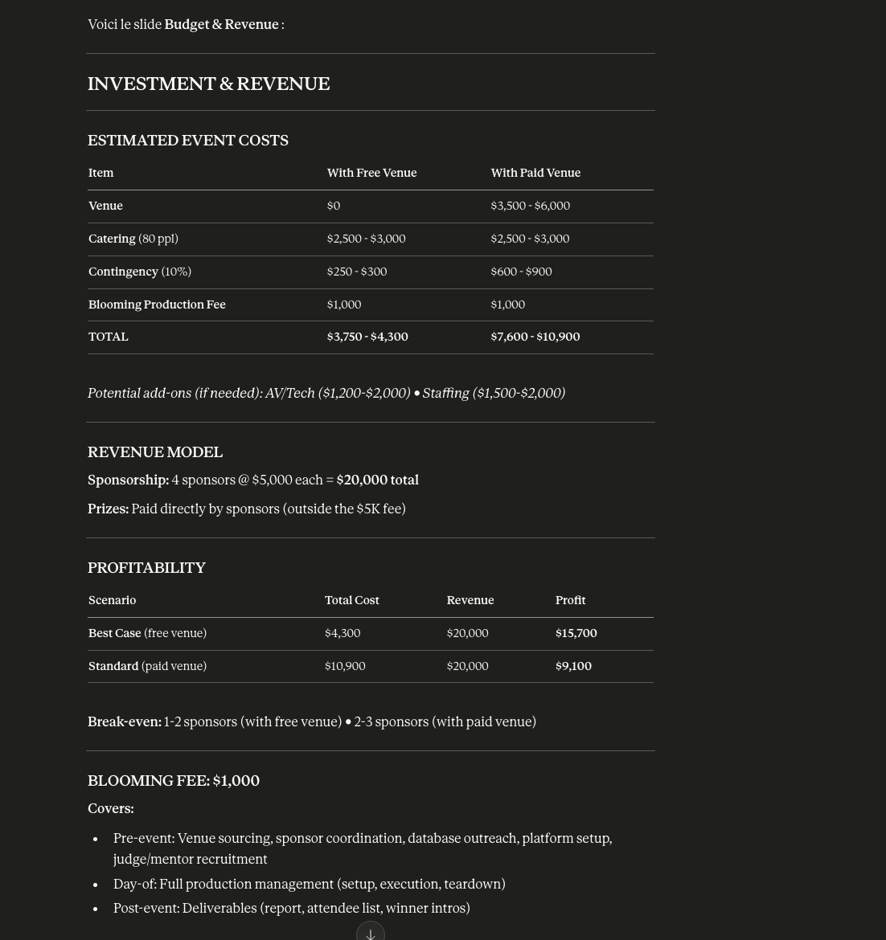
IF SPONSORSHIP AT 5K

Slide 7
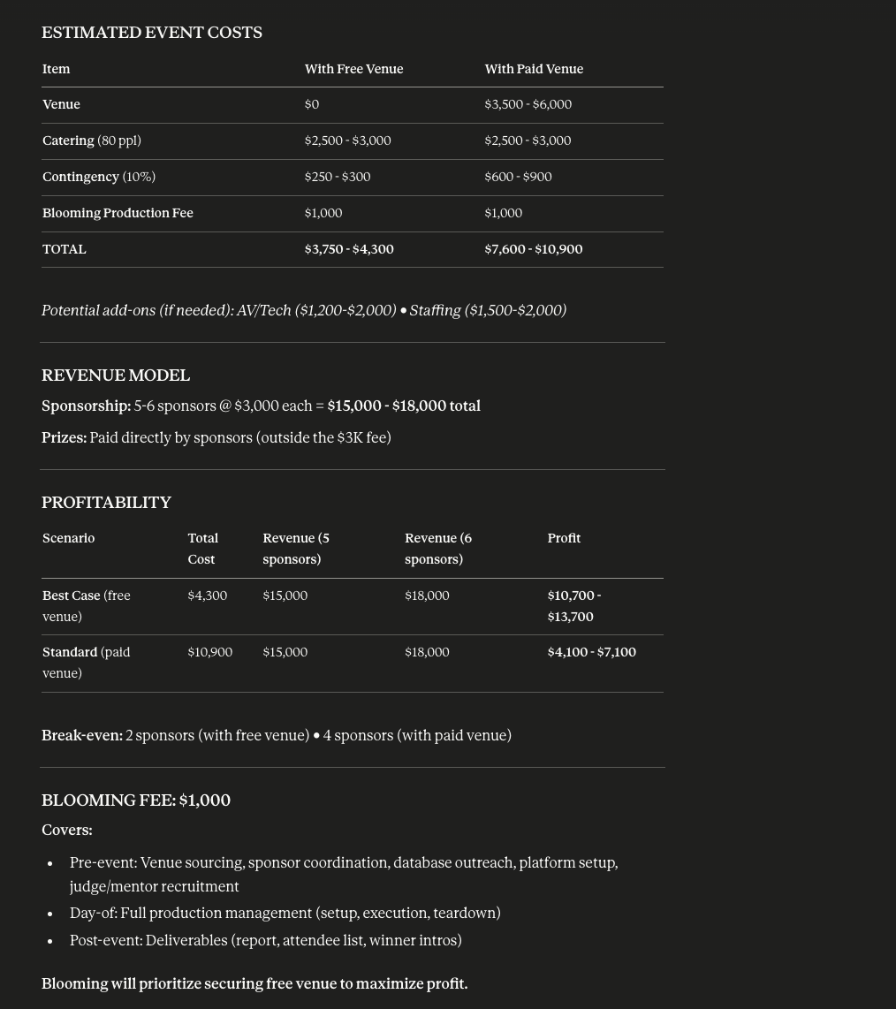
IF SPONSORSHIP AT 3K

